Slide 1
IoT-Based Blood Bank Inventory Management system
Vandana Bhinge 2GI20EC156
Anjana Zare 2GI20EC182

Slide 2
Introduction
The IoT-based Blood Bank Management System leverages Raspberry Pi and cloud computing to enhance blood storage and distribution. Raspberry Pi sensors monitor temperature, ensuring blood safety. GPS tracking enables real-time location of blood shipments, optimizing delivery routes. Data from sensors and GPS is sent to the cloud for analysis and remote access. This system improves blood bank efficiency, ensuring proper storage conditions and timely deliveries, ultimately saving lives by providing a reliable supply of safe blood products.

Slide 3
Objectives:
Blood Inventory Management
GPS Location Tracking
Remote Access and Control
Alerts and Notifications
User Authentication and Access Control
Privacy and security
Cost Efficiency
Improve Patients Care

Slide 4
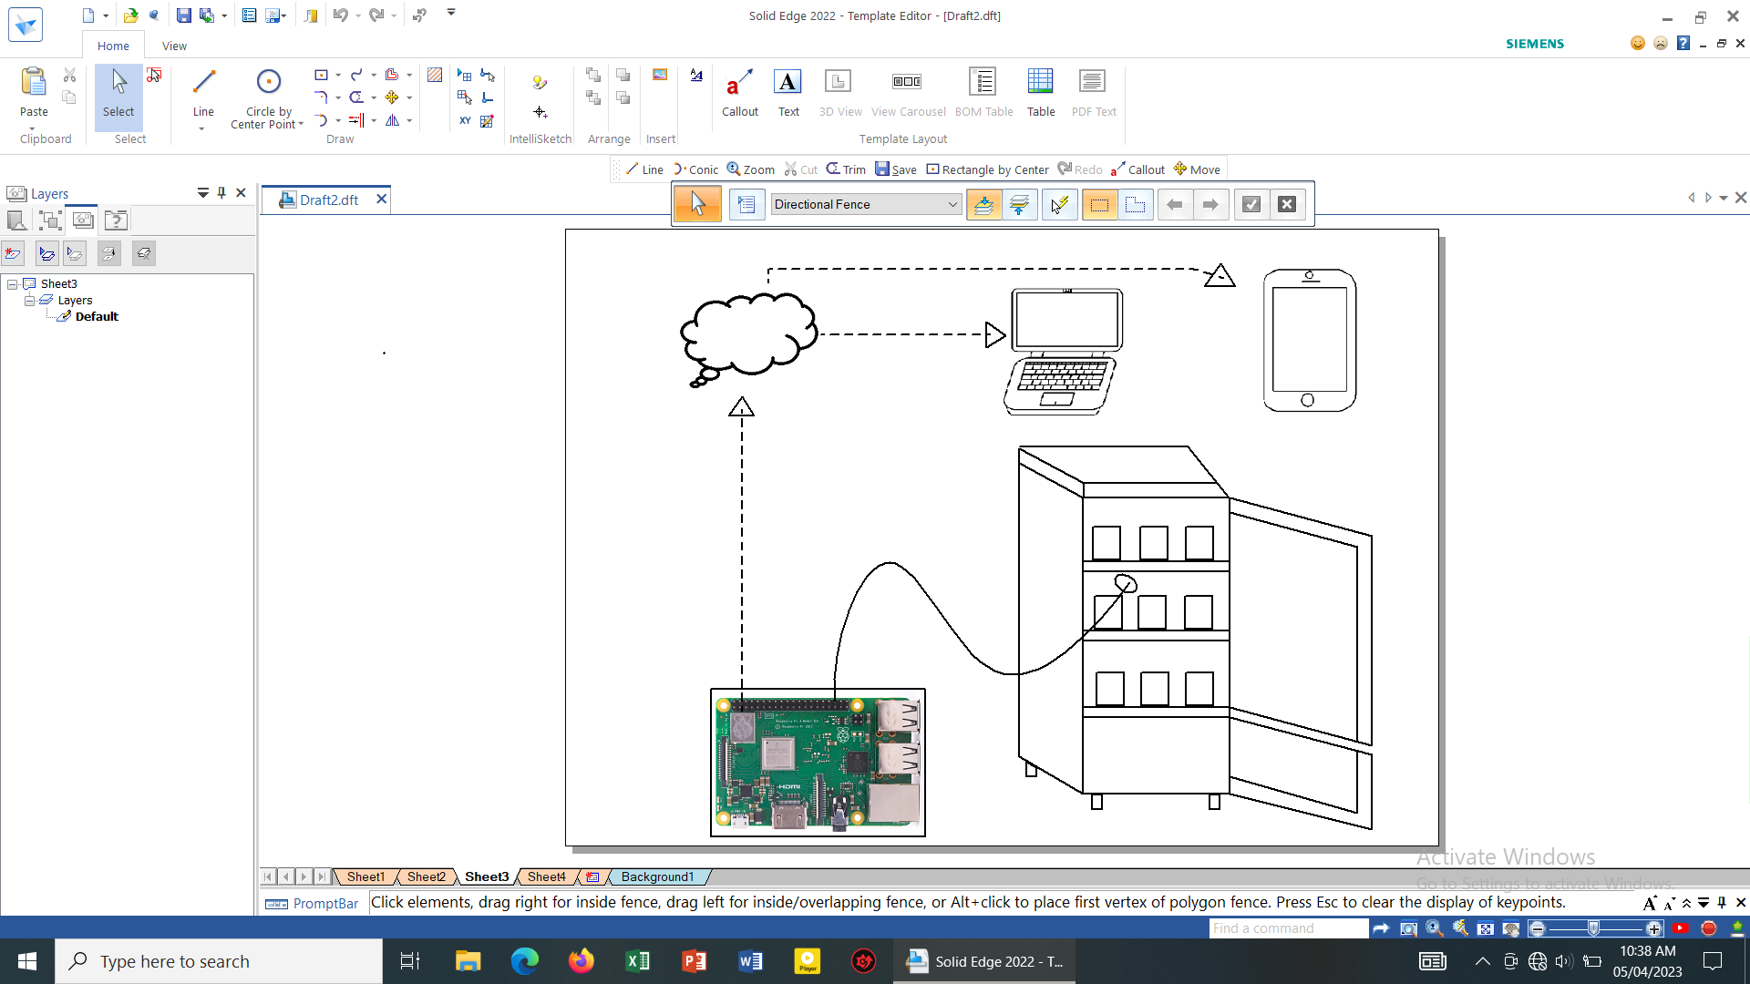
Block Diagram and Methodology

Slide 5
Methodology :
Requirements Gathering
System Architecture
Raspberry Pi Setup
Cloud-Based GPS Tracking
Blood Inventory Management
Data Collection and Processing
User Authentication and Access Control
Alerts and Notifications

Slide 6
Data Sources
Donor Information
Inventory Data
GPS Tracking Data
User Data
Languages Used
Python Programming
MySQL
HTML

Slide 7
Software Required
Raspberry pi OS
DBMS
Web Application
IOT Platform
Hardware Required
Raspberry Pi

Slide 8
References:
[1] Qadeer, M.A., Imran, A., "Asterisk Voice Exchange: An Alternative to Conventional EPBX", International Conference on Computer and Electrical Engineering, 2008. ICCEE 2008.
[2] Kapicak, L. ,Nevlud, P. , Zdralek, J. , Dubec, P. , Plucar, J. "Remote control of Asterisk via Web Services", 34th International Conference on Telecommunications and Signal Processing (TSP), 2011
[3] M. Voznak, L. Kapicak, J. Zdralek, P. Nevlud and J. Plucar , "Multimedia services in Asterisk based on VoiceXML", International journal of mathematical models and methods in applied sciences.
[4] Peter Marbach, Oliver Mihatsch, and John N. Tsitsiklis, "Call Admission Control and Routing in Integrated Services Networks Using Neuro-Dynamic Programming", IEEE Journal on selected areas in communications, VOL. 18, NO. 2, FEBRUARY 2000 .
[5] Sripanidkulchai, K., Shu Tao, Zon-Yin Shae "DA VINCI: A tool to improve VoIP call routing
configurations", IEEE Network Operations and Management Symposiwn (NOMS), 2010.
*Papers need to be listed in descending order of published year

Slide 9
Thank You

